Slide 1


Submitted :- Harsh Tanwar
BCA 3rd Sem
Session 2025 - 2028

Slide 2

Digital Marketing
Assignment Report
--------------------------------------------------------------------------------------------------------------------------------------------------------------------------------
Assignment Folio of
Digital Marketing
Submitted to
Dezyne École College
Toward Digital Marketing
By
BCA
3rd Semester
Harsh Tanwar
ASSIGNMENT FOLIO
Dezyne École College
106/10, Civil Lines, Ajmer
www.dezyneecole.com
2026-2027
--------------------------------------------------------------------------------------------------------------------------------------------------------------------------------

Slide 3
Digital Marketing
Acknowledgement
--------------------------------------------------------------------------------------------------------------------------------------------------------------------------------
ASSIGNMENT FOLIO
We take this opportunity to express our sincere gratitude to Dezyne École College for providing us with the knowledge,
resources, and guidance essential to the successful completion of this project.
Our deepest thanks to our respected Principal, Dr. Vinita Mathur, for her visionary leadership and continuous encouragement.
Her commitment to academic excellence and student growth has been a constant source of motivation and pride.
We are equally thankful to all our faculty members for their consistent support, expert advice, and valuable insights that
shaped our learning and helped us achieve this milestone.
Lastly, we extend heartfelt thanks to everyone who directly or indirectly contributed to the success of this project.
We are proud to be part of Dezyne École College, an institution that truly nurtures professionalism, innovation, and purpose.
With sincere appreciation,
Harsh Tanwar
Department – BCA
Dezyne École College, Ajmer
--------------------------------------------------------------------------------------------------------------------------------------------------------------------------------

Slide 4
Digital Marketing
Case Study
--------------------------------------------------------------------------------------------------------------------------------------------------------------------------------
ASSIGNMENT FOLIO
Objective:
Increase Website Traffic, Generate Quality Leads, Improve Brand Visibility, Boost Course Enrollments & Maximise ROI
1. Search Campaign Strategy
Targeted high-intent keywords related to computer courses.
2. Structure Ad Groups
Separate ad groups for each course to improve relevant and Quality Score.
3. Optimized Wix Landing Page
Mobile-friendly design with strong call-to-action buttons.
4. Conversion Tracking Setup
Measure form submission and call clicks for performance analysis.
5. Smart Bidding Strategy
Used “Maximize Conversions” to optimize ad spend automatically.
--------------------------------------------------------------------------------------------------------------------------------------------------------------------------------

Slide 5
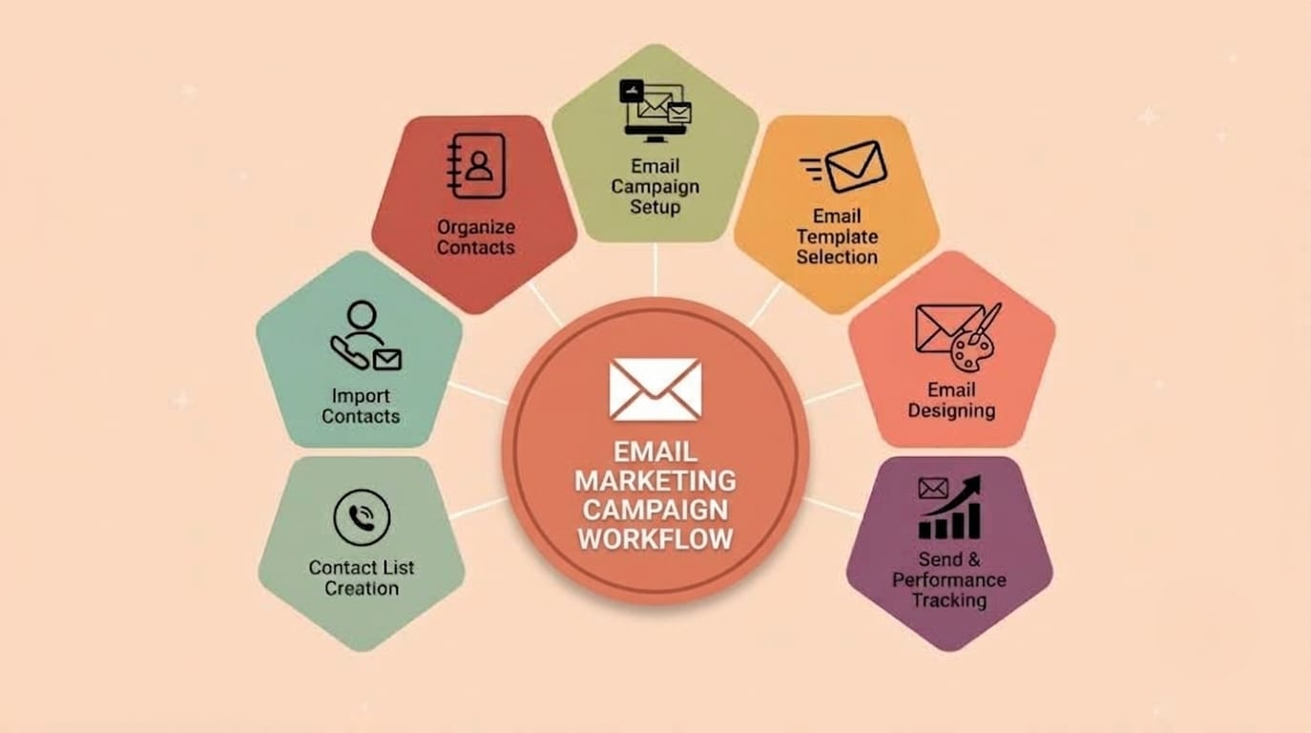

Slide 6

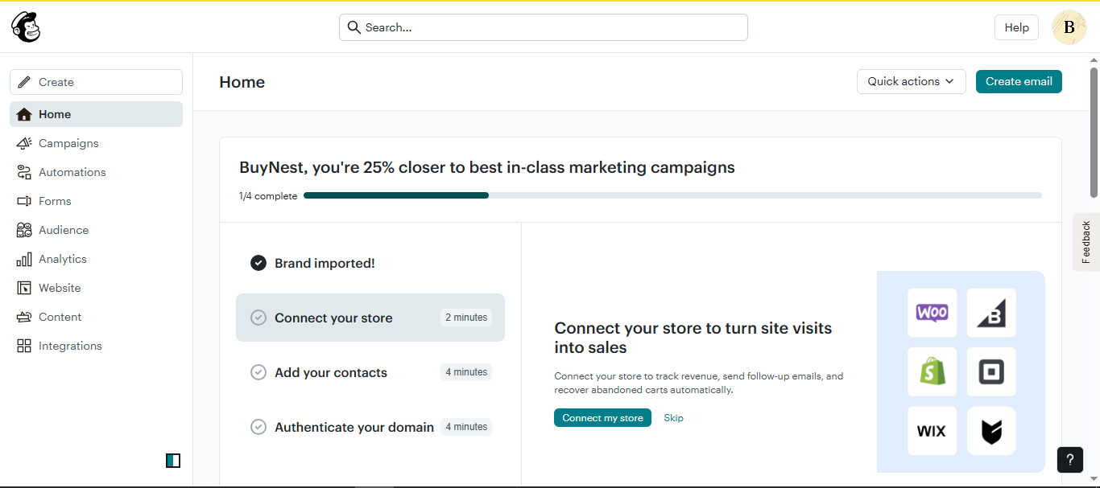
Mailchimp Account Setup

Slide 7
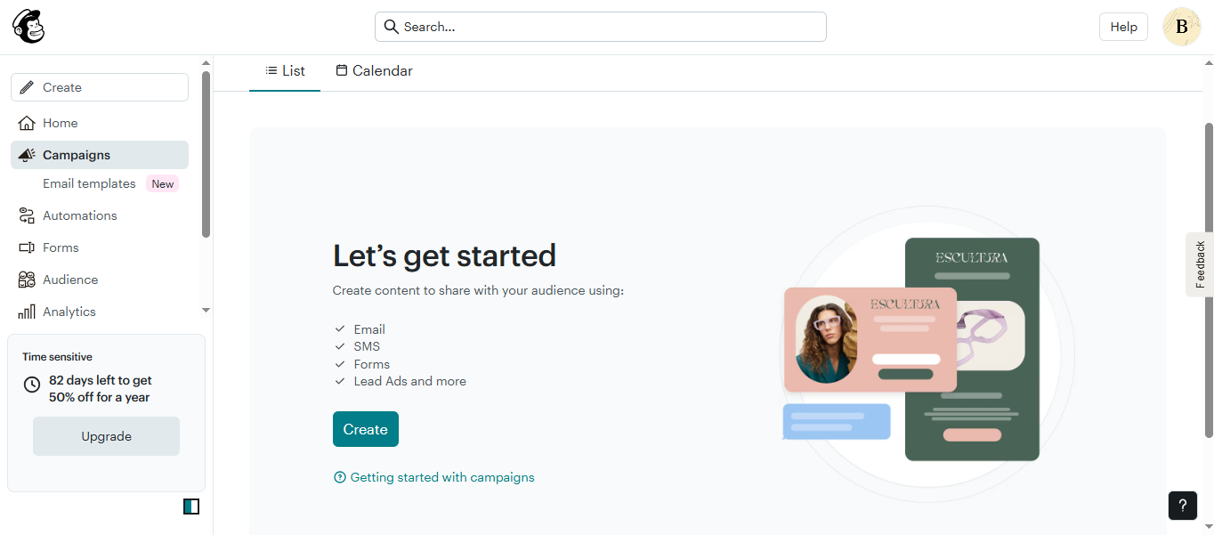
Email campaign Dashbord

Slide 8
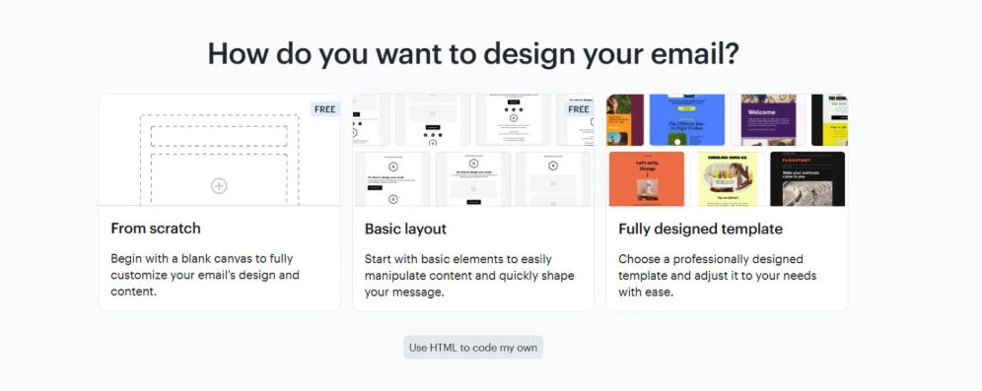
Email Design Method Selection

Slide 9
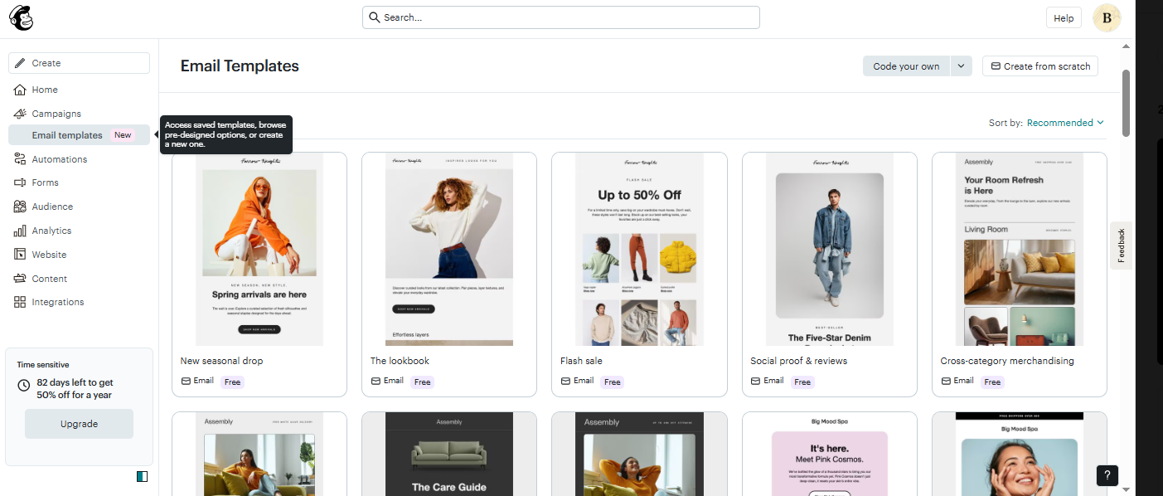
Email Template Selection

Slide 10
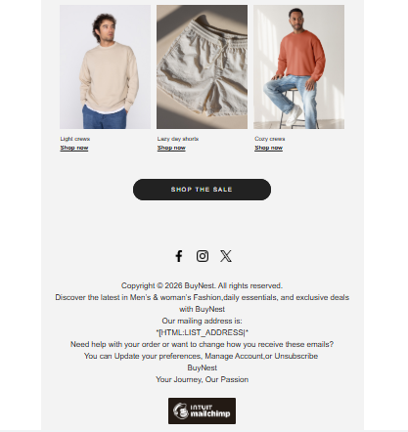
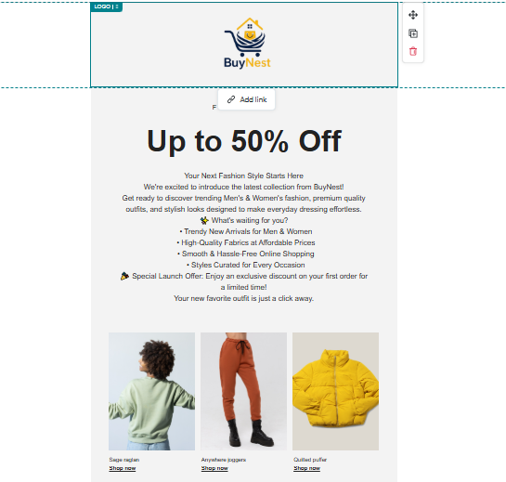
Email Design & Customization

Slide 11
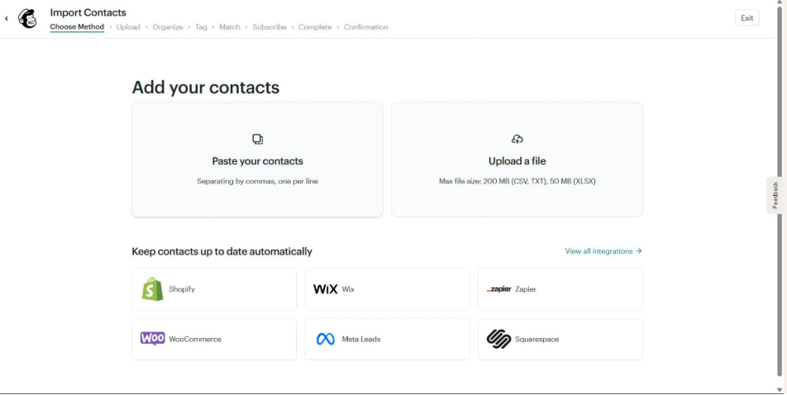
Contact Import Method Selection

Slide 12
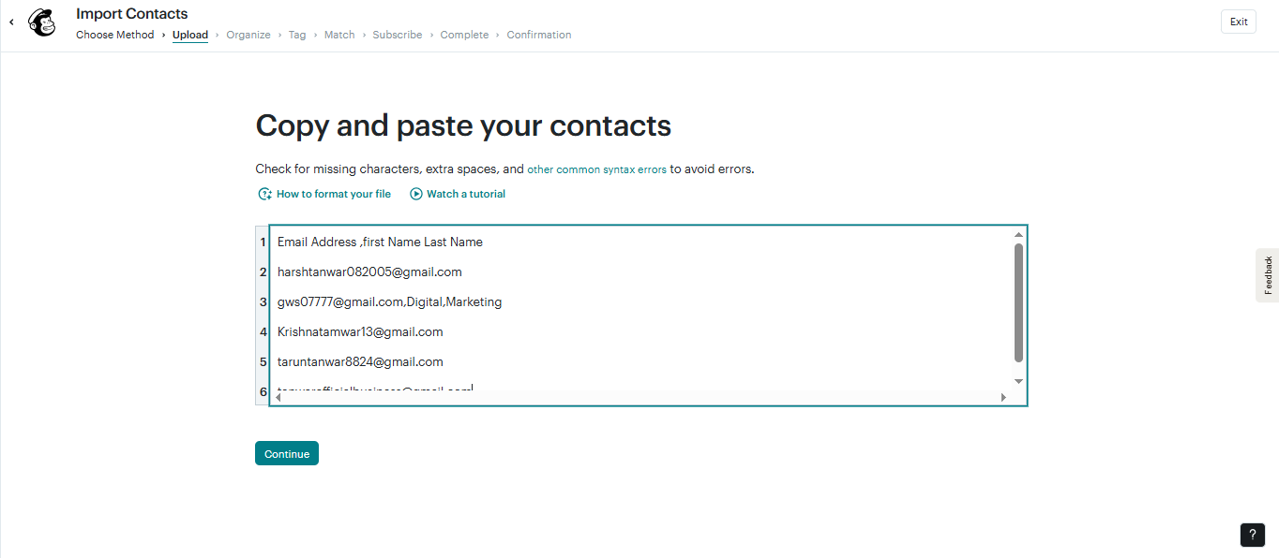
Copy & Paste Your Contacts

Slide 13
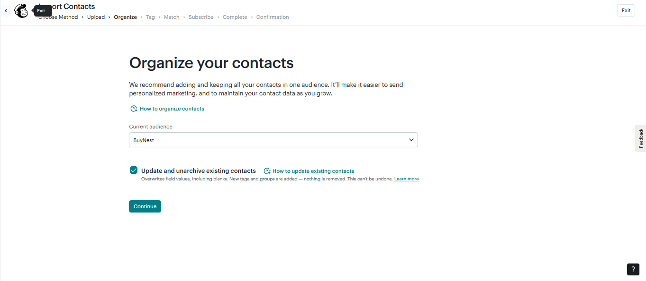
Organize Your Contacts

Slide 14
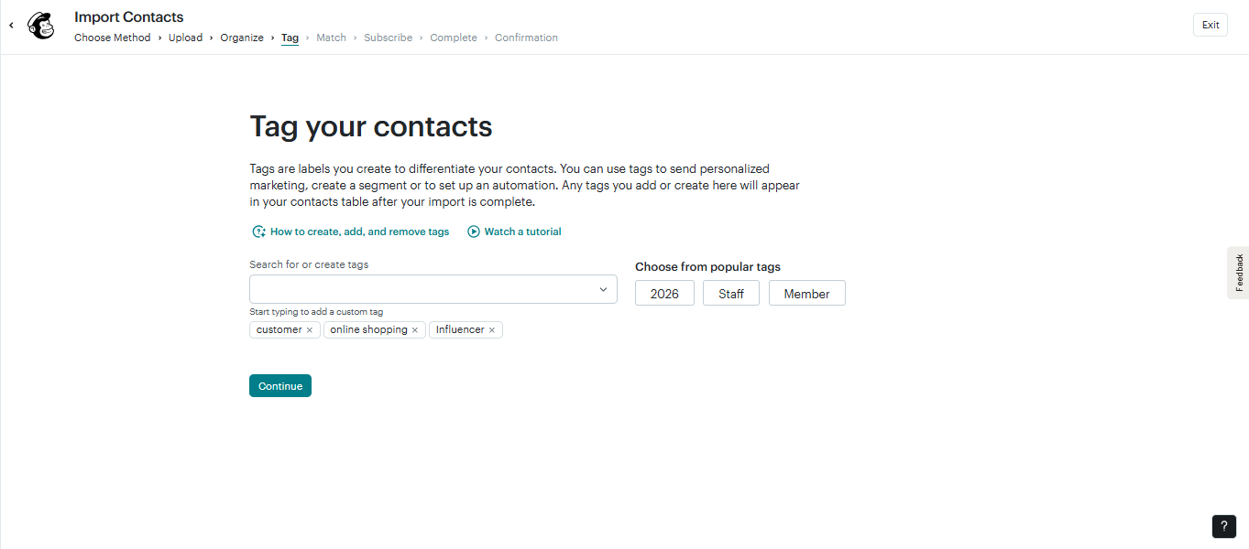
Tag Your Contacts

Slide 15
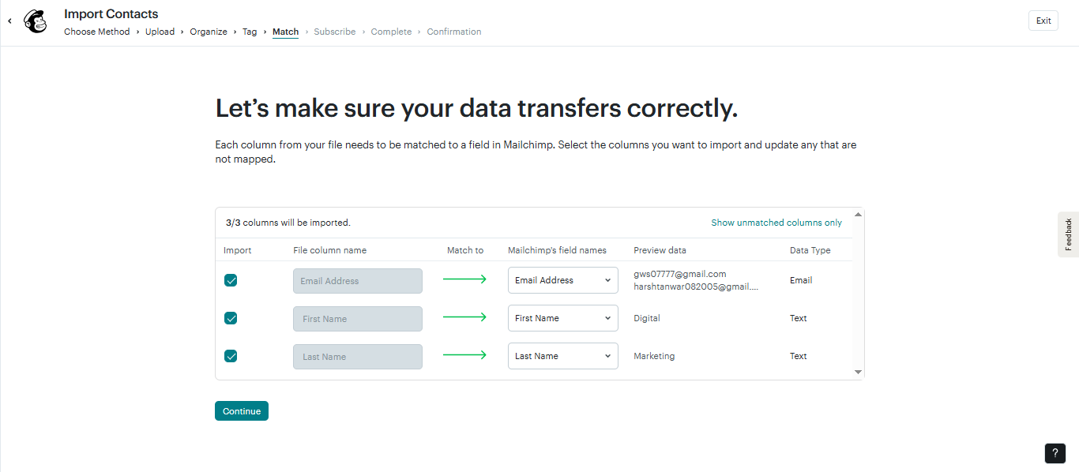
Contacts Imported Successfully

Slide 16
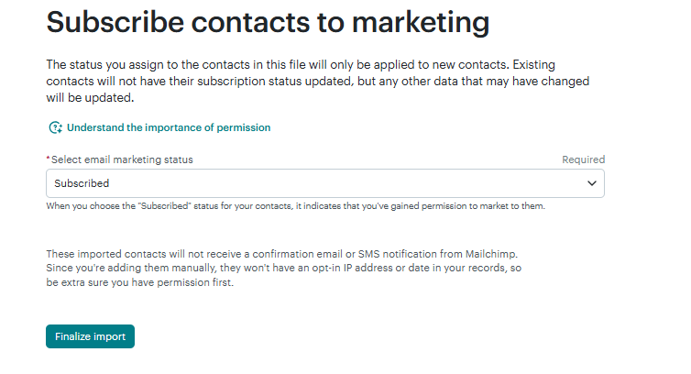
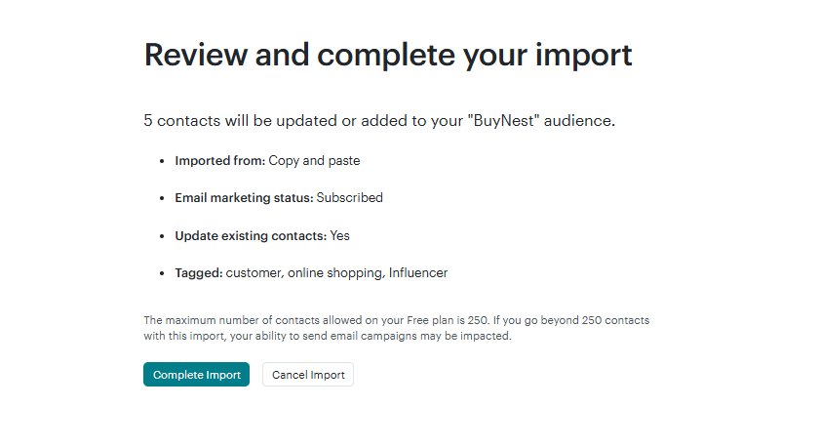
Import Completion

Slide 17
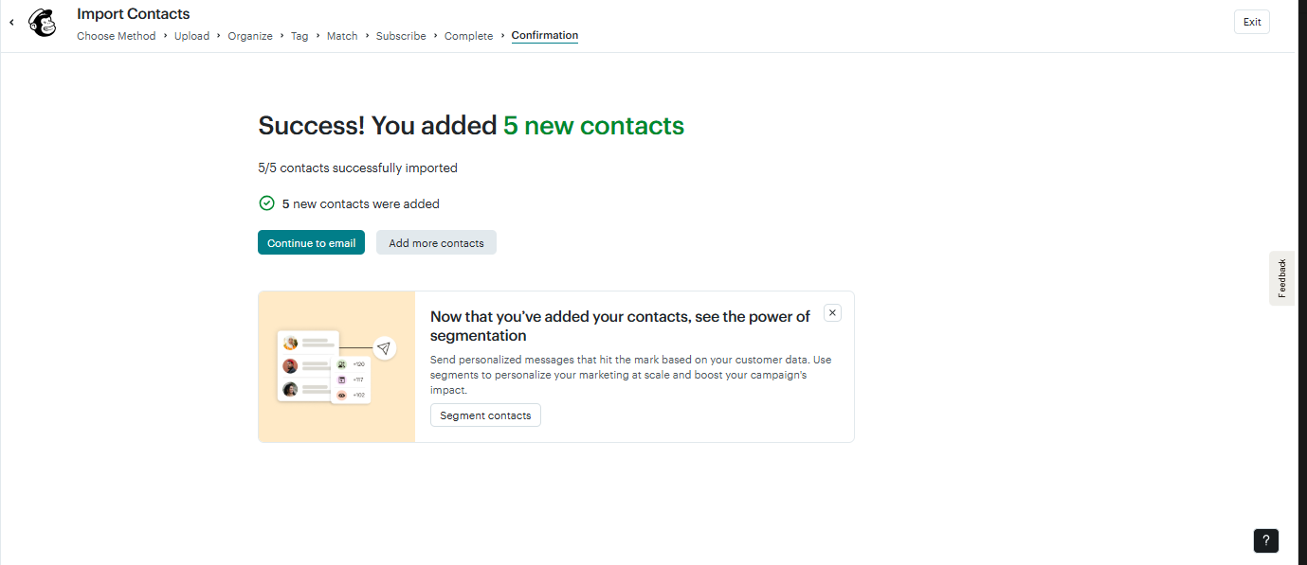
Import Confirmation

Slide 18
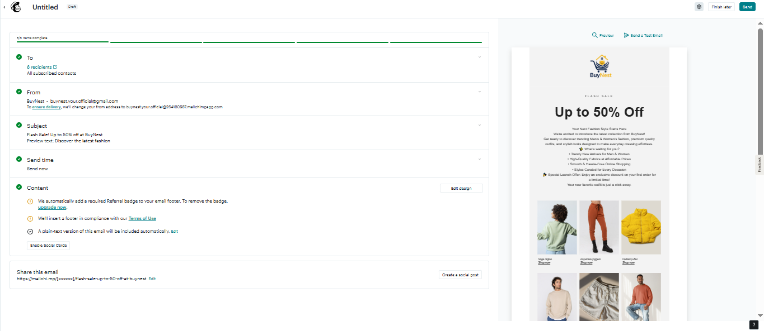
Campaign Preview

Slide 19
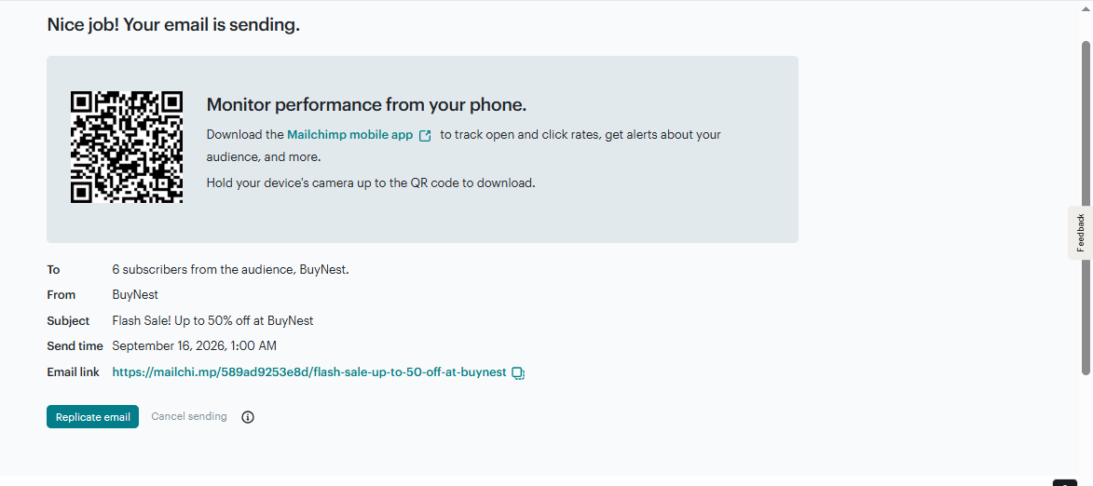
Campaign Successfully Launched

Slide 20
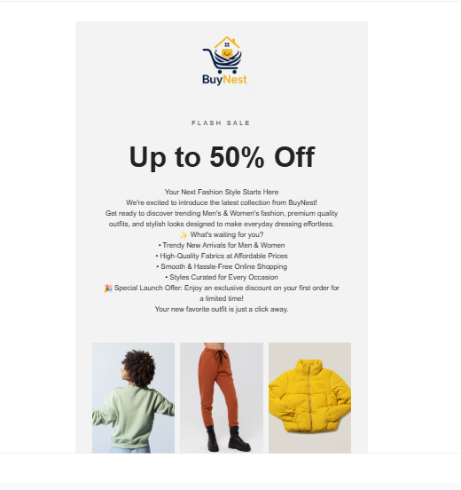
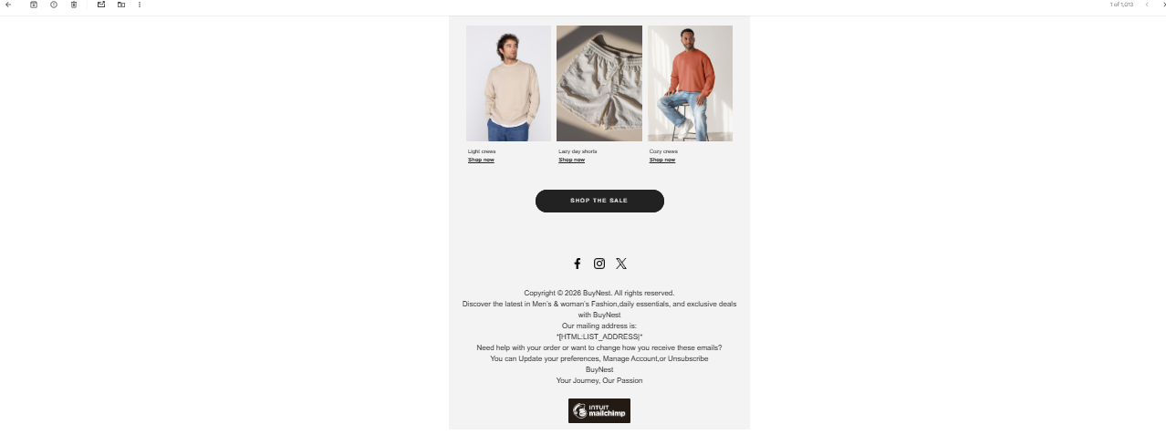
Test Email

